Slide 1


Age, Animation, & Similarity
An Educational Odyssey

Slide 2
“Students will learn how to run representational similarity analysis (RSA) on an fMRI dataset of 4-12 year olds passively viewing emotional and neutral video clips. The workshop will focus on running RSA analyses within ROIs across the medial temporal lobe. In this workshop, participants will gain expertise on fMRI pre-processing, head motion correction in a developmental sample, modeling of single-trial events, and RSA. Analyses will be performed using a combination of FSL, Matlab, and R.”

Slide 3
WHAT
A
MOUTHFUL!!

Slide 4
“Students will learn how to run representational similarity analysis (RSA) on an fMRI dataset of 4-12 year olds passively viewing emotional and neutral video clips. The workshop will focus on running RSA analyses within ROIs across the medial temporal lobe. In this workshop, participants will gain expertise on fMRI pre-processing, head motion correction in a developmental sample, modeling of single-trial events, and RSA. Analyses will be performed using a combination of FSL, Matlab, and R.”

Slide 5

Goals of this presentation are to provide:
A basic understanding of fMRI data preparatory procedures related to RSA
A basic overview of fMRI-related analyses
A basic understanding of the theory, applications, and limitations of RSA
A brief overview of a project using RSA

Slide 6

What I won’t cover with this presentation:
Operating an fMRI and collecting fMRI data
FSL scripting
Matlab’s role in RSA
In-depth examples of RSA’s versatility

Slide 7
fMRI: The Basics
Functional Magnetic Resonance Imaging (fMRI) measures brain activity by detecting changes associated with blood flow.
More specifically, how do we define “activation”?
Haemodynamic Response, commonly BOLD response
Some pushback on the BOLD (Gonzalez-Castillo et al., 2012)
Where are we detecting this activation?
Neurons, more specifically Voxels

Slide 8
MRI For Our Purposes
Important to note!
There are different forms of MRI:
Structural – Sequences volume of brain structures
Functional
Diffusion – Sequences pathways connecting the brain
I’m going to differentiate between anatomical and functional imaging

Slide 9

Project in Progress
Somewhat unusual circumstances
Defining our tools first and project second
Sample: 21 young adults [20 yr – 44 yr] and 30 children [04 yr – 10 yr]
MRI & Demographic Data
Stimuli: 24 film clips, 3 Conditions, ~16 minutes in total

Slide 10
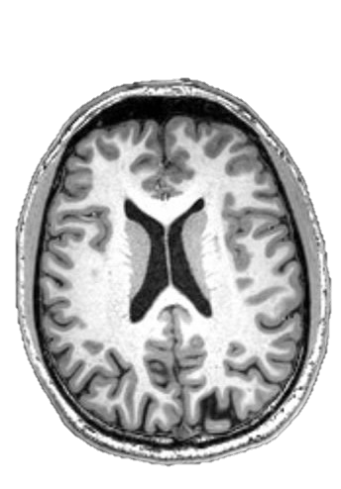
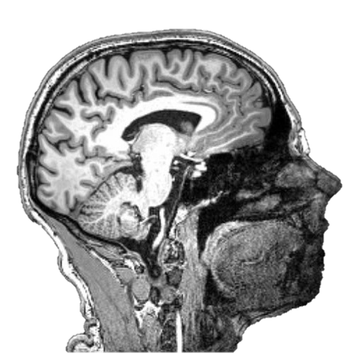
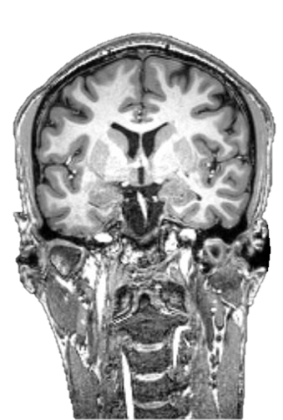
fMRI: Results

Slide 11

fMRI: Software
Plenty of options!
I’m familiar with FSL
FSL has a number of tools that are really important for us to make sense of this data:
Brain Extraction Tool (BET)
FEAT
FAST
FLIRT

Slide 12
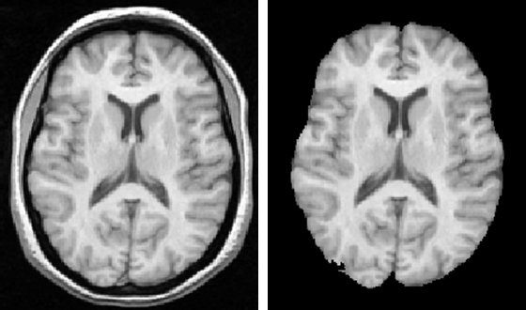
FSL: BET
Anatomical tool
BET essentially just removes all of the stuff that we DEFINITELY don’t want.
Skull, non-Brain related tissue, spinal cord, etc.
Perhaps most important is Visual Inspection!

Slide 13
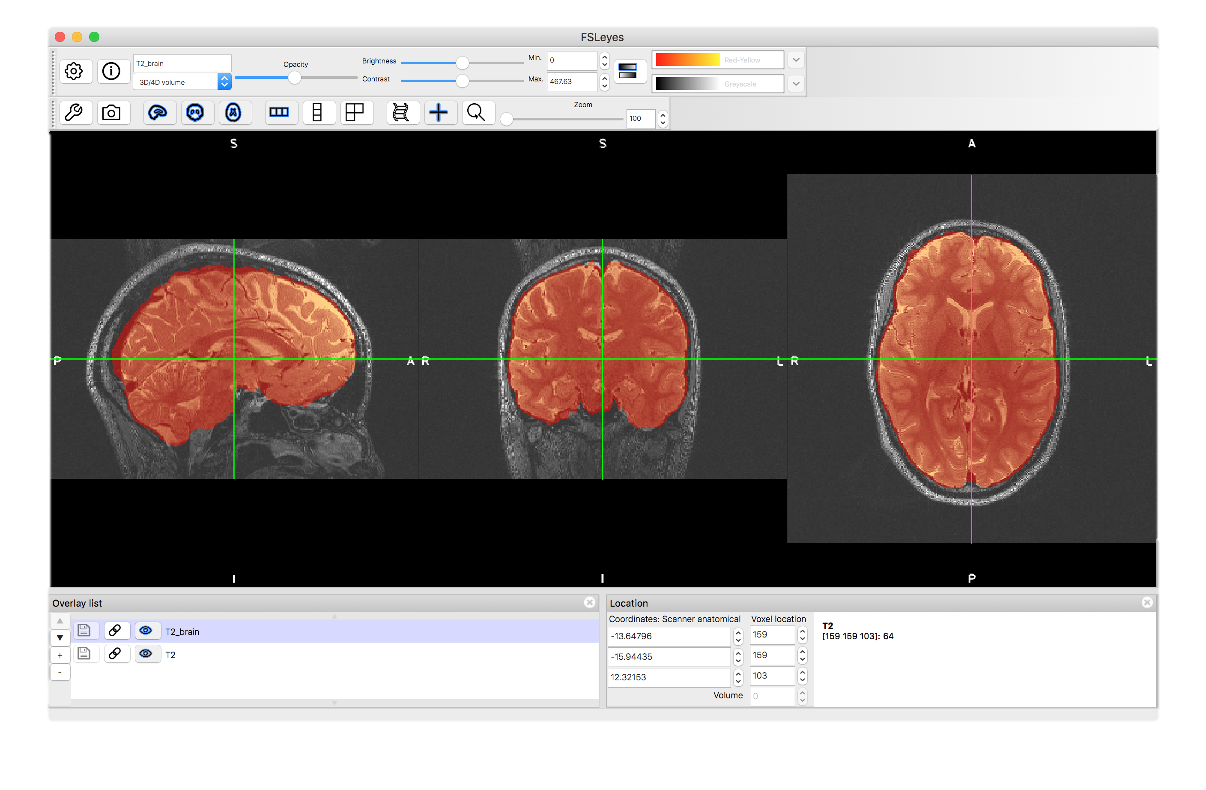
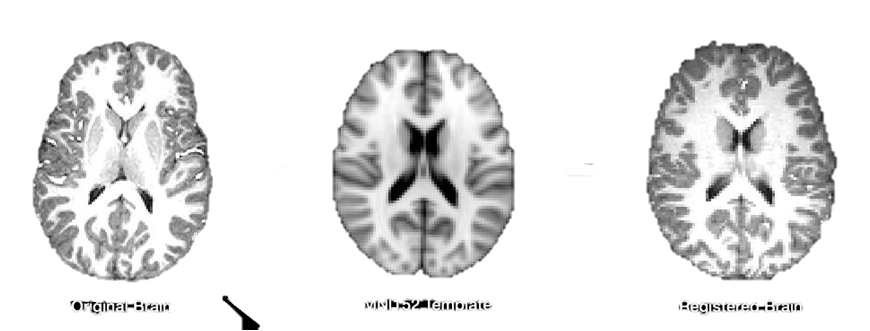
FSL: Fast, Flirt, & Feat
FAST: Program that segments an anatomical brain image into grey matter, white matter, and CSF
The anatomical image not captured at the same time as the functional image
FLIRT: Program that allows us to realign the anatomical images into the functional space.
We can standardize our images using the MNI152 template with FLIRT

Slide 14
Now that we have our scans, we’re kind of ready to do something with them!

Slide 15

fMRI-Related Analyses : Univariate
Dependent Measure: BOLD Signal Magnitude
Question: “Does activation magnitude in [Area X] differ between [Condition A] and [Condition B]?”
Mass-Univariate Analysis – Univariate Analysis run simultaneously across every voxel in the brain.
So what’s the problem?
Univariate Analysis techniques can tell you which regions are working on a task, but not how those regions are working on a task.
LET’S D ANALYSES

Slide 16
fMRI-Related Analyses : Multivariate
Dependent Measure: Pattern Classification in Activation
Question: “What patterns emerge in [Voxel Set X] when exposed to Stimuli X, Y, Z, etc.]?”
“Pattern classification relies on the idea that there are systematic differences in the variability of voxels that differ between conditions of interest” (Dimsdale-Zucker & Ranganath, 2019).
When used in conjunction with a Classifier, Multivoxel Pattern Analysis (MVPA) can predict what an individual might be thinking of within a trial.
A classifier is a computer learning algorithm that is trained to categorize data based upon similar data.
So what’s the problem?
Multivariate techniques and MVPA work great with categories, but can’t tell us much about our thinking patterns in a higher-dimensional space.

Slide 17
fMRI-Related Analyses : Representational Similarity Analysis
Dependent Measure: Similarity in Voxel Patterns
Question: “How similar are the responses among [Voxel Set X] when exposed to [Stimuli X, Y, Z, etc.]?”
Possibly a misnomer? but not really…
You can focus on dissimilarity or similarity in representation (Dimsdale-Zucker & Ranganath, 2019; Popal et al., in review)
Can provide more insight into what information is being processed in what areas of the brain and how that information is organized.
The basis is the Representational Dissimilarity Matrices, in which all stimuli are compared to one another, and is symmetrical along its diagonal.

Slide 18
RSA: Strengths
Can compare status representations across multiple-dimensions
Can work with individual stimuli rather than categories
Allows comparison of data from different sources
Allows comparison of data from different species

Slide 21
RSA: Limitations
Still susceptible to fMRI noise
Create a voxel-signal distribution and remove outliers
Create a voxel-signal distribution and only include voxels that are likely contributing signal.
Not a great fit for all trial designs.
Demands equal trial numbers between conditions
Concerns that pattern differences might be driven by overall activation magnitude.
Especially the case if using a Searchlight Analysis

Slide 22
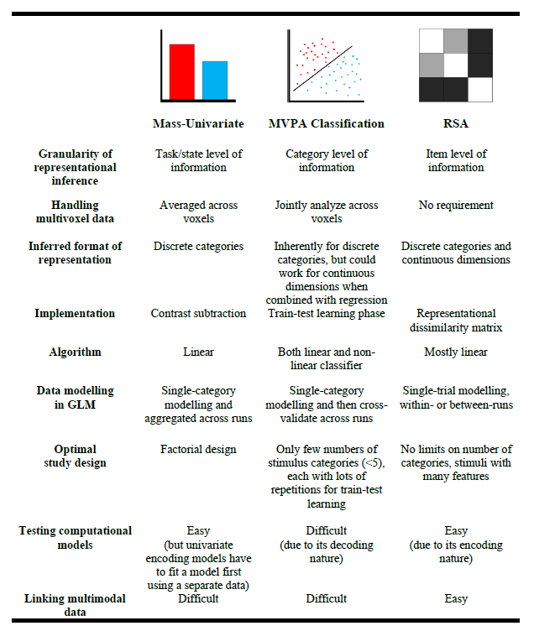

Slide 23
Project in Progress: Stimuli
Stimuli: 24 film clips, 3 Conditions, ~16 minutes in total
Very specific arrangement:
12 animated, 12 live action
8 positively, 8 negatively, and 8 neutrally valenced
At least 9 sources, with each source providing one negative and one positive clip

Slide 24


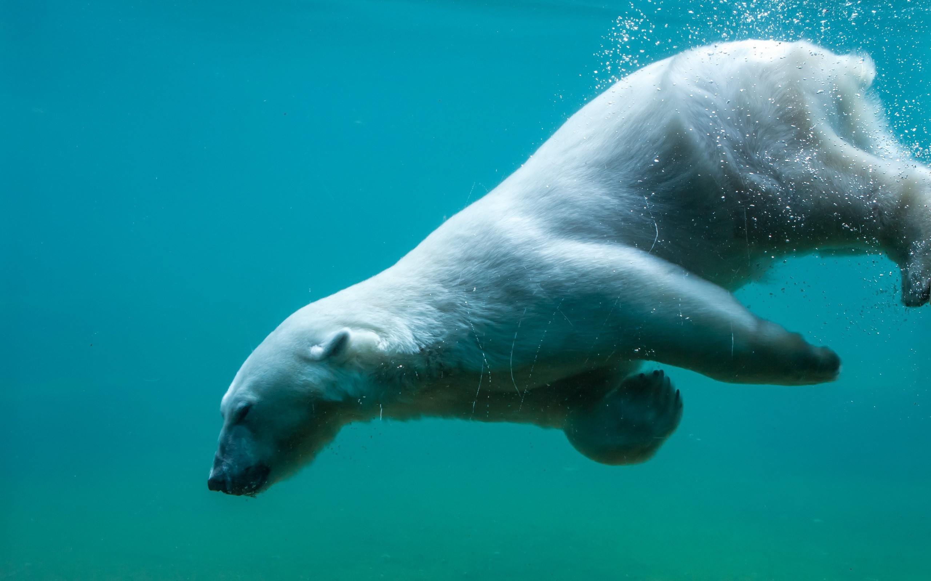

Slide 25
What We’re Workin’ Wit Here
Open Season
Lion King
Anastasia
Wizard of Oz
Shark Boy and Lava Girl
Rio
Up
Little Mermaid
Random Nature Videos

Slide 26
Project In Progress: ROIs
Nucleus Accumbens
Important in rewards systems and processing rewarding stimuli (Olsen, 2011)
Amygdala
supports detection of salient stimuli and is selective for identifying fear (Lindquist et al., 2012)
Important in evaluations of emotions, particularly disgust, fear, worthiness, guilt, and embarrassment (Blakemore, 2008)
Perirhinal Cortex
Important in recognizing familiar items
Perihippocampal Cortex
Important in recognizing familiar context
Hippocampus
Important in recognizing the relationship between familiar items and contexts

Slide 27
Project in Progress: Variables
Age
Sex
Live-Action vs. Animation
Person vs. Animal vs. Anthropomorphic Entity
Musical characteristics (Tempo, Timbre)
Visual representations
Emotional Language
Power Dynamics
Popularity

Slide 28
Video 1 Tone | Video 2 Tone | Video 3 Tone
Positive | Negative | Positive
Negative | Positive | Negative
Neutral | Neutral | Neutral
Positive | Negative | Positive
Negative | Positive | Negative
Neutral | Neutral | Neutral
Positive | Positive | Positive
Negative | Negative | Negative
Neutral | Neutral | Neutral
Positive | Positive | Positive
Negative | Negative | Negative
Neutral | Neutral | Neutral
Negative | Positive | Negative
Positive | Negative | Positive
Neutral | Neutral | Neutral
Negative | Negative | Negative
Positive | Positive | Positive
Neutral | Neutral | Neutral
Negative | Negative | Negative
Positive | Positive | Positive
Neutral | Neutral | Neutral
Negative | Negative | Negative
Positive | Positive | Positive
Neutral | Neutral | Neutral

